Slide 1


Library Management System
Our library management application offers a comprehensive solution to handle all your book-related needs. From searching for titles to managing user information and borrowing processes, this platform puts the power in your hands.
Bilge Kağan ÖZKAN - Tuna ÖZTÜRK

Slide 2




User Features
1
2
3
Borrow Books
Request a book from librarian by providing your student ID and the book's ID.
View User Info
Search Books
Access your personal book history, due dates, and fees.
Easily find books by name, author, or ID.

Slide 3



Librarian Features
Book Management
User Management
Add and remove books.
Monitor and manage user borrowing and returning activities.

Slide 4

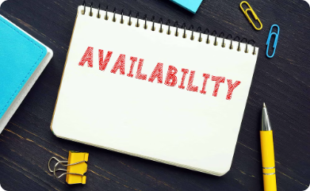

Book Details
Book Information
Availability
Borrowing Process
View the title, author, type, and location of a book.
Check if the book is currently available or checked out.
Initiate the borrowing process by providing your student ID.

Slide 5
User Information
Borrowed Books
Due Dates
View a list of the books you have currently borrowed.
See the due dates for returning borrowed books.
Borrowing Time
Returning Time
See the borrowing date for borrowed books.
See the returning date for borrowed books.
Fines
Payment Status
Check any outstanding fees for late returns or lost books.
Manage the status of any fines or fees you need to pay.

Slide 6





Borrowing Process for User
Search Book
Search book by name, author or ID and check their availabilities.
Select Book
Identify the book you want to borrow by its ID.
Provide ID
Provide your student or book ID to librarian to initiate the checkout.
Checkout
Complete the borrowing process and receive your book.

Slide 7




Borrowing Process for System
Claim Book ID, Student ID and, Date from Librarian
Librarian claims book, student ID and date, then enters them to the system.
Update Avaliability Status of The Book
Change the availability of the book to "No" in the database.
Assign Book to The User
System assigns the book to the relevant user and stores information in database.

Slide 8
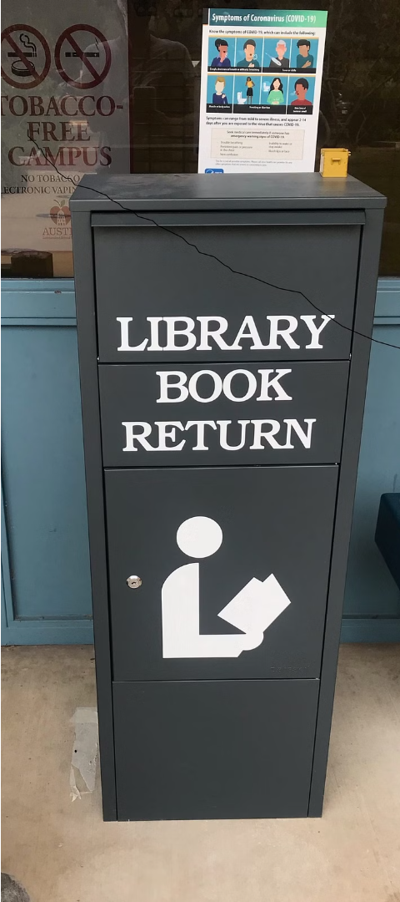
Returning Process for User
Return Back The Book to The Library
Identify the book you want to return by its ID and student ID.
Check Paid Status
If you passed the due date, you must pay a penalty ten dollars per week.

Slide 9

Returning Process for System
Claim Book ID, Student ID and, Date from Librarian
Librarian claims book, student ID and, date then enters them to the system.
Check Due Date and Returning Time
Compare the due date and returning time then record returning time in the database.
Payment Penalty
If there is any late returning, calculate penalty as a 10 dollars per week then keep payment information in the database.
Update Avaliability Status of The Book
Change the availability of the book to "Yes" in the database.

Slide 10

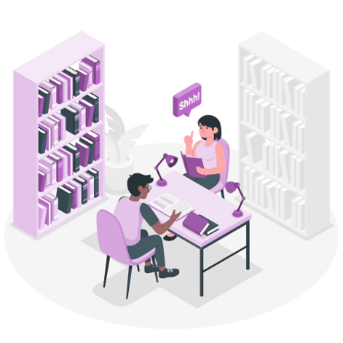

Other Features
Login Process
User Types
Error Management
Users and Librarians must login to use the system
Users and Librarians online access their user-specific features
When a user attemps unauthorized actions system gives error.

